Slide 1
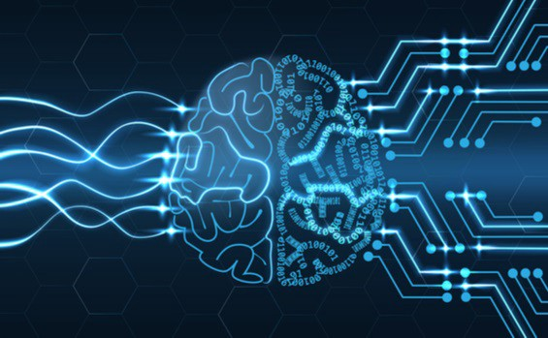
BRAIN GATE
PRESENTATION BY
M.KOKILA
GEC ,ERODE

Slide 2

CONTENTS
INTRODUCTION 7.WORKING
HISTORY OF BRAIN GATE 8.APPLICATION
PRINCIPLE 9.CONTROLLING ROBOTS
NEED OF BRAIN GATE 10.A BOON TO PARALYSIS
BRAIN GATE RESEARCH 11.ADVANTAGES
HOW IT IMPLEMENTS 12.INSPIRATION
13.CONCLUSION

Slide 3
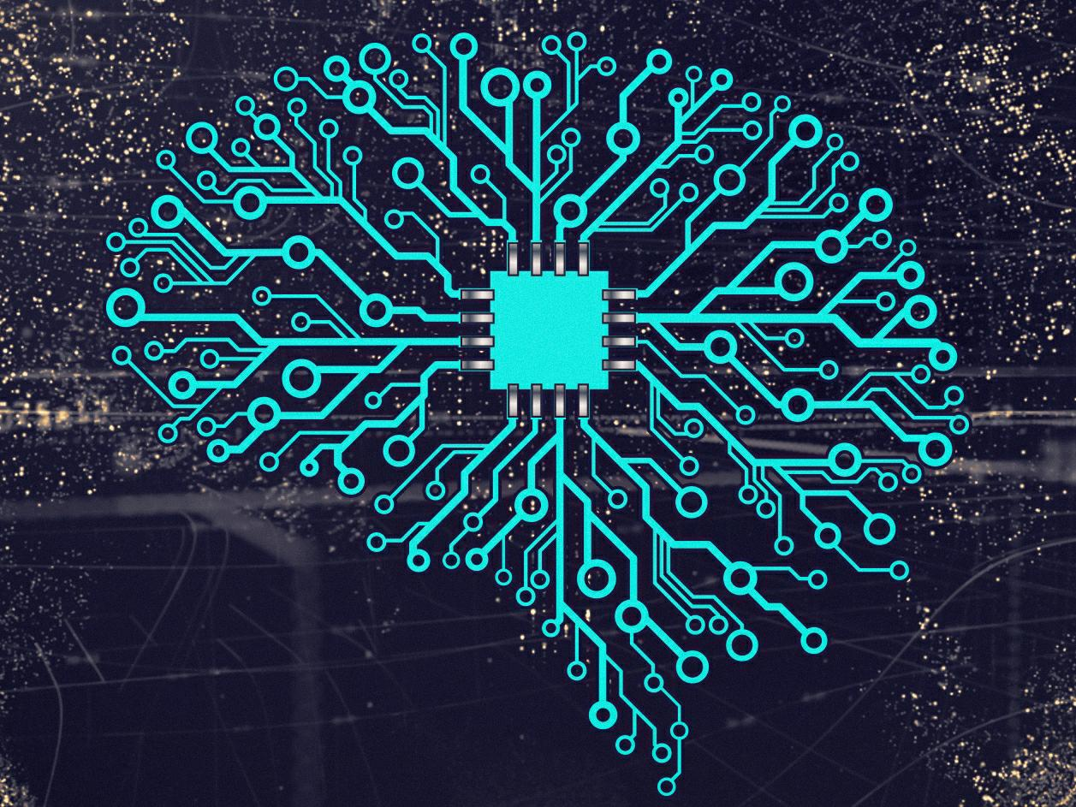
BRAIN GATE
Brain gate technology is a technology that is previously owned by cyber kinetics and is currently under developments. This technology is a brain –nerve interface .we can read minds and transform thinking under brains into live actions. We can implement our imaginations.

Slide 4

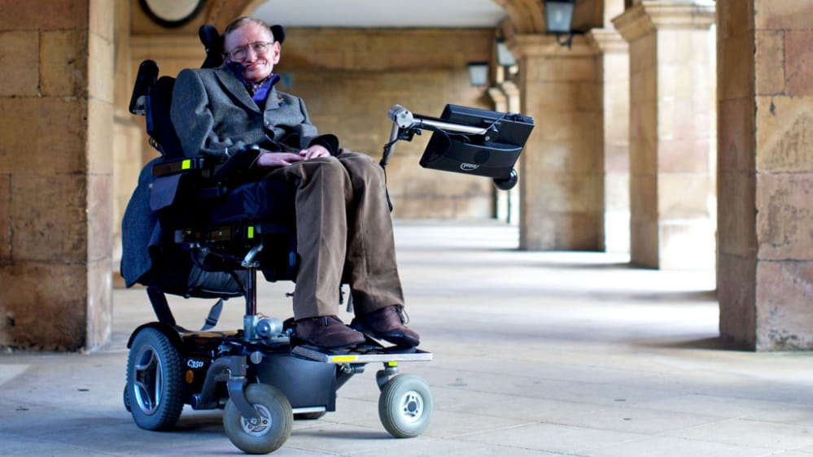
HISTORY OF BRAIN GATE
Brain gate is a brain implant system developed by the biotech company cyber kinetics in 2003 in conjunction with the development of neuroscience at brown university .
The device was designed to help those who have lost control of their limbs ,or other bodily functions ,such as patients with amyotrophic lateral sclerosis (ALS) or spinal cord injury.

Slide 5
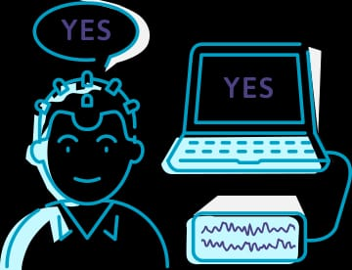
PRINCIPLE
The principle of operation of the BRAINGATE NEURAL INTERFACE SYSTEM is that with intact brain function ,neural signals are generated even though they are not sent to the arms ,hands and legs .
Conversion of internal neural signal into output signal under the users control by using an 100 electrode-chip.

Slide 6

Need of brain gate
300,000 Americans are spinal cord injury.
52% of spinal cord injured individuals are considered partial paralysis and 48% total paralysis .
Approximately 5,000 new injuries occur each year .
86% are male,56% of injuries are age of 16 to 30

Slide 7
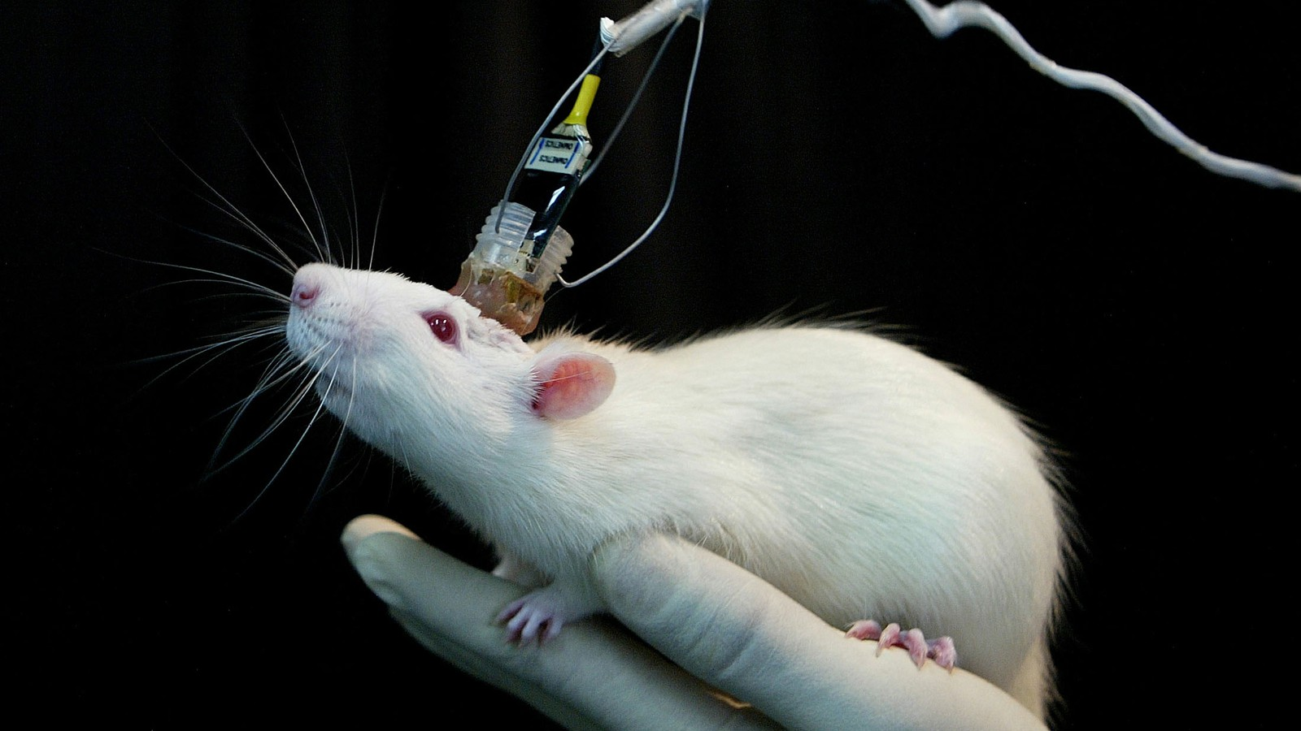
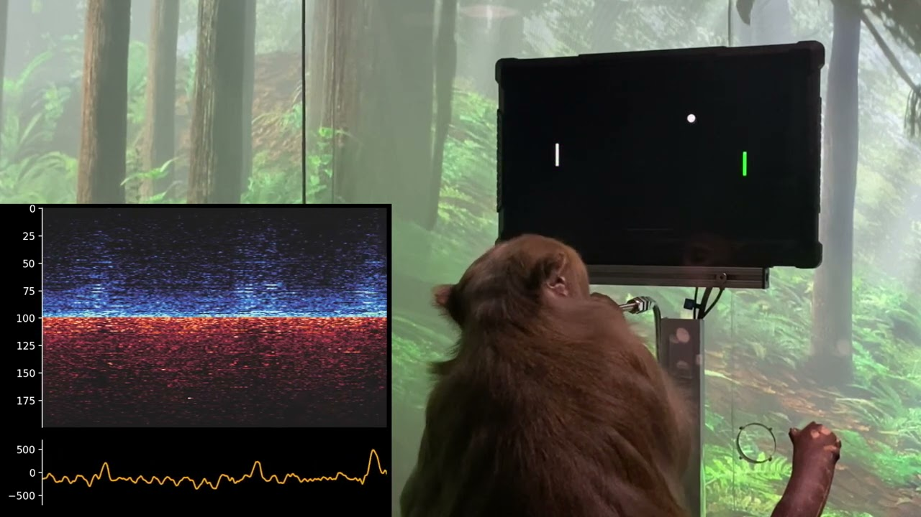
Brain gate research
1 st on rat ,signals recorded from the cerebral cortex of rat to operate BCI to carryout the movement .
Next on monkeys ,since there were no complication in trials with monkey
SOON TO BE IMPLEMENTED ON HUMANS

Slide 8
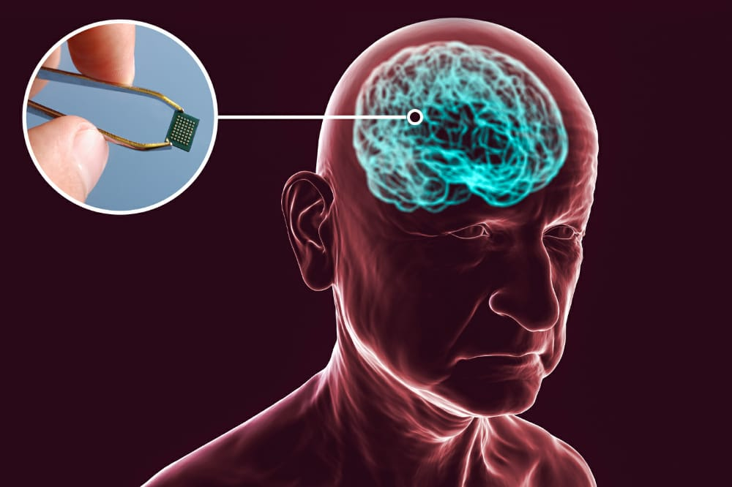
HOW IT IMPLEMENTS
SENSE
TRANSMIT & ANALYSE
APPLY

Slide 9
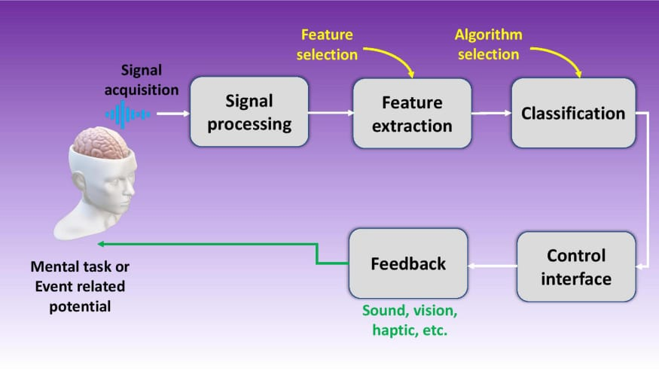
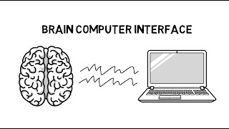
WORKING
The computer chip, which is implanted in the brain, monitors
brain activity in the patient and converts the intention of the user into computer commands .

Slide 10
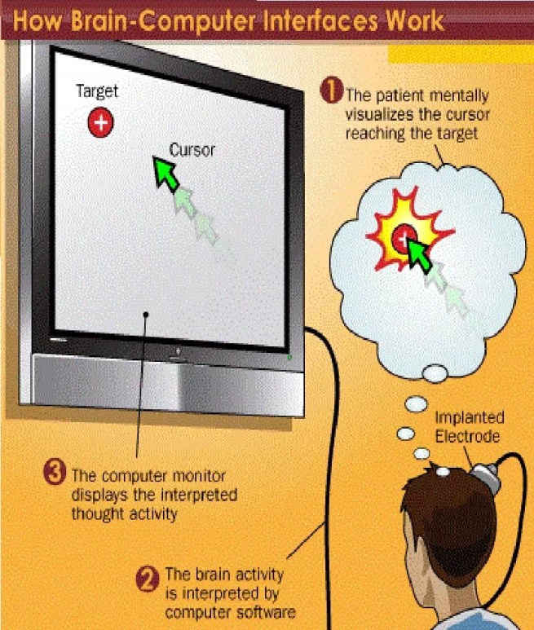
APPLICATION
This technology is well supported by the latest fields of
Biomedical instrumentation
Microelectronics
signal processing
Artificial neural networks
Robotics

Slide 11
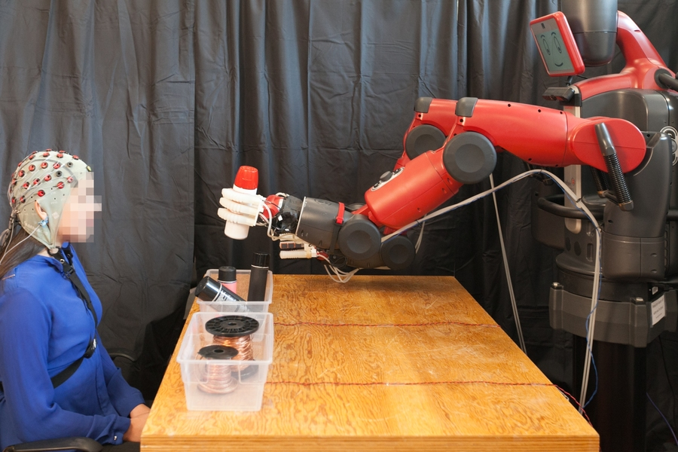
CONTROLLING ROBOTS
A brain–machine interface (BMI) is a device that translates neuronal information into commands capable of controlling external software or hardware such as a computer or robotic arm. BMIs are often used as assisted living devices for individuals with motor or sensory impairments.

Slide 12
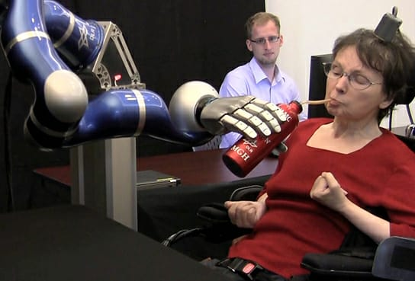
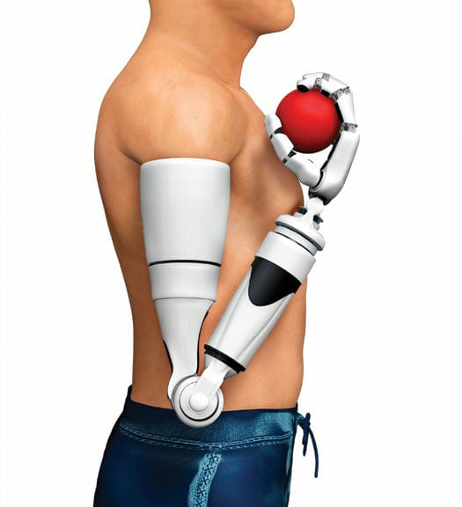
A BOON TO PARALAYSIS
Mathew –Nagel the first person to use the brain computer.
Interface to restore functionality lost due to paralysis

Slide 13
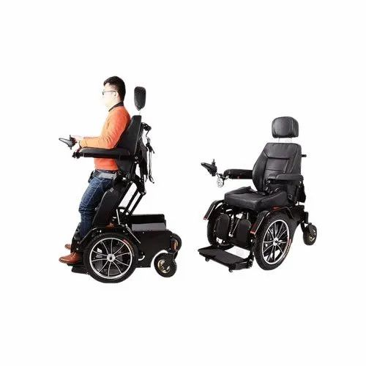
Advantages
Controlling remote devices
Making and receiving telephone calls
Accessing the internet
Turn on or off the lights
Control robotic arm
Watch and control television
Locking or unlocking doors
Motorized wheelchair

Slide 14
Inspiration
Brain gate as a dream capture
Deep inside the temporal lobe of the brain, the hippocampus has a central role in our ability to remember, imagine and dream. Our most vivid dreams are a remarkable replication of reality, combining disparate objects, actions and perceptions into a richly detailed hallucinatory experience. So recording dream is my inspirational idea from brain gate.

Slide 15
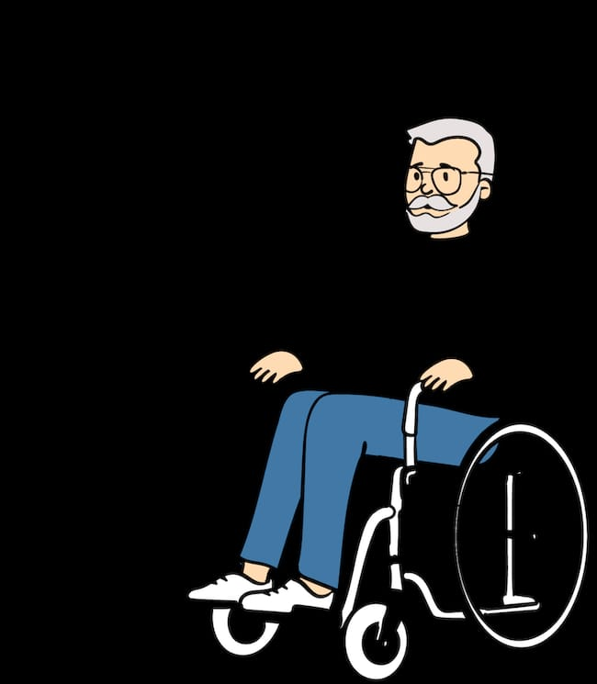
conclUsion
The invention of brain gate is such a revolution in medical field .The remarkable breakthrough offers hope that people who are paralysed will one day be able to independently operate artificial limbs computers or wheelchairs.
Brain gate is a powerful gift because it can bring the
GIFT OF HOPE

